Slide 1
Digital Logic Design EE(109)

Slide 2
Chapter No:5
Combinational Logic Analysis

Slide 3
CHAPTER OUTLINE
Basic Combinational Logic Circuits
Implementing Combinational Logic
The Universal Property of NAND and
NOR Gates
Combinational Logic Using NAND and
NOR Gates
Pulse Waveform Operation

Slide 4
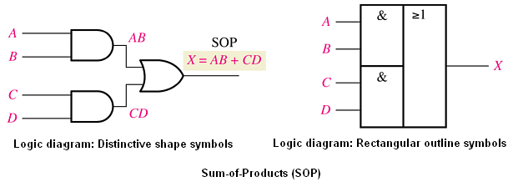
Basic Combinational Logic Circuits
AND-OR Logic

Slide 5
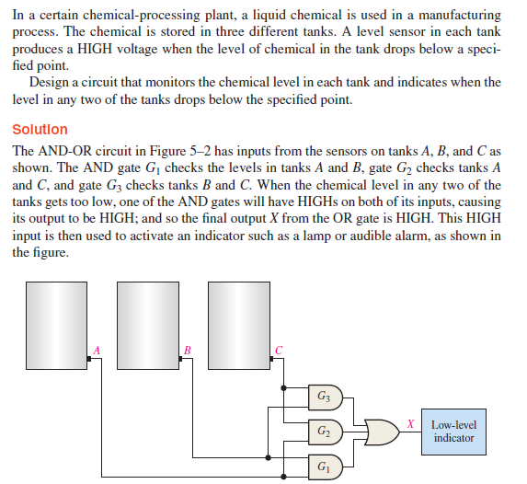
Example

Slide 6
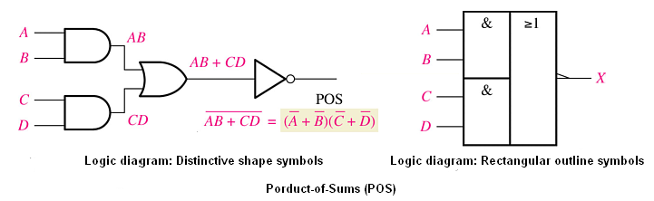
Basic Combinational Logic Circuits
AND-OR Invert Logic

Slide 7
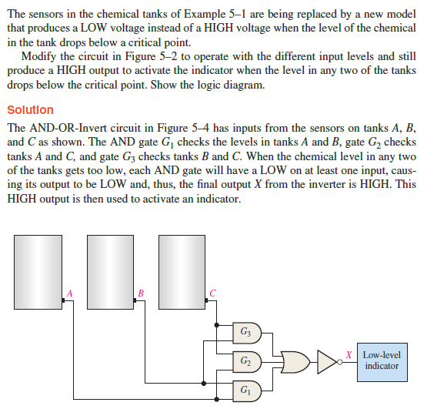
Example

Slide 8
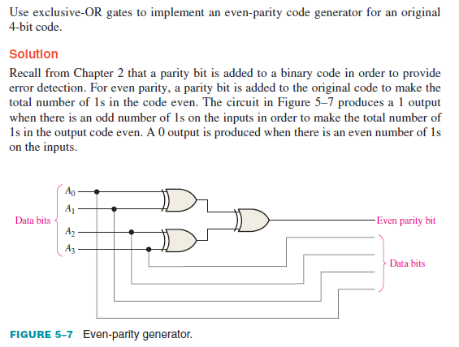
Example

Slide 9
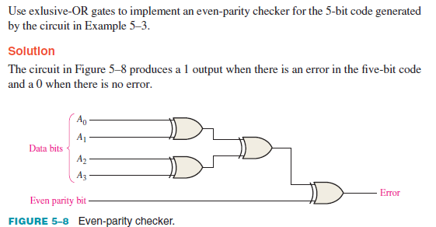
Example

Slide 10
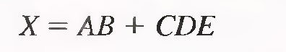
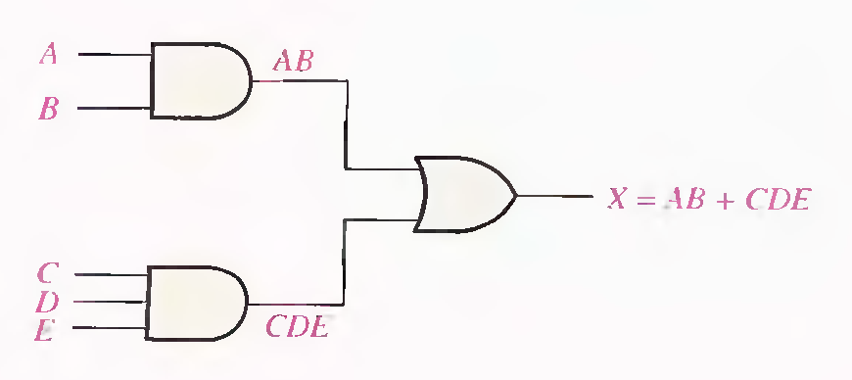
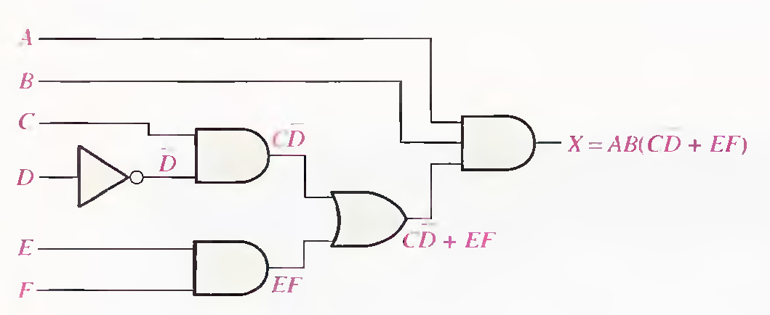
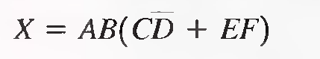
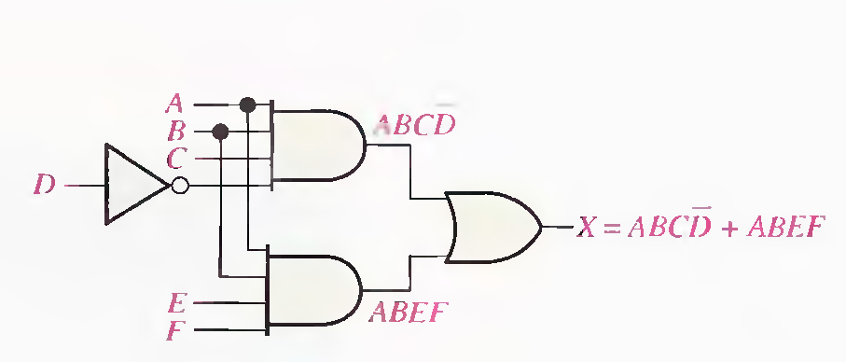
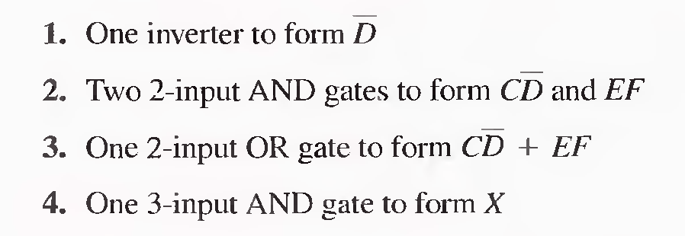
Implementing Combinational Logic

Slide 11

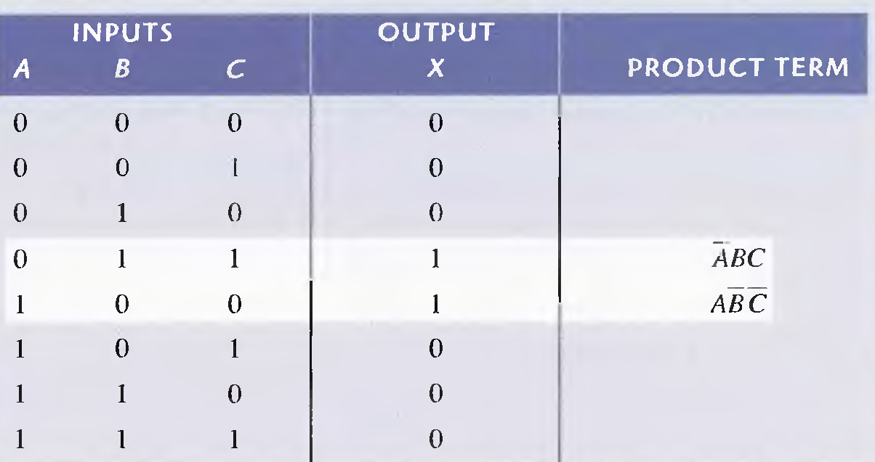
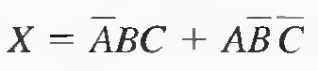
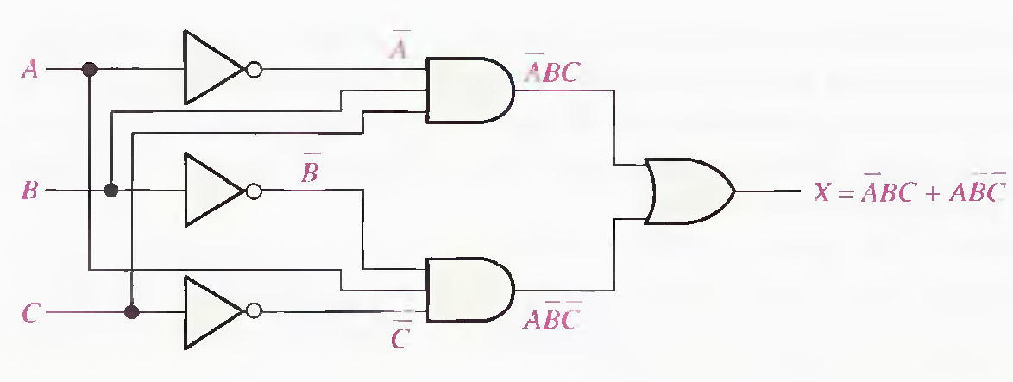

Slide 12
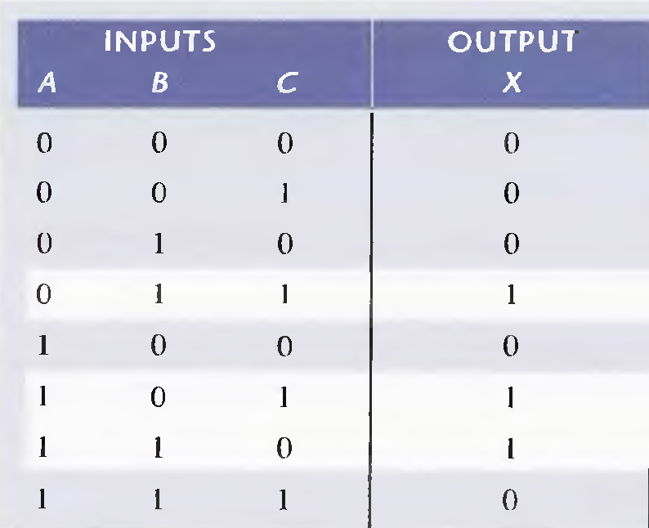
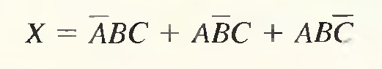
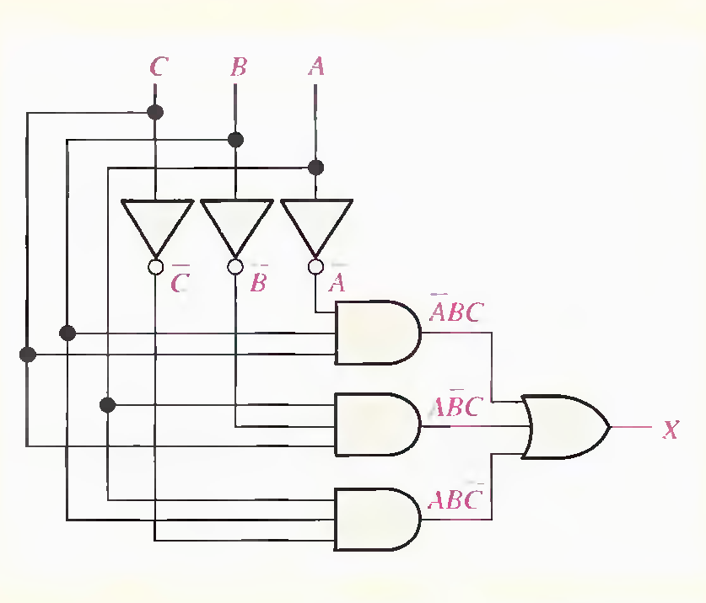
Example

Slide 13
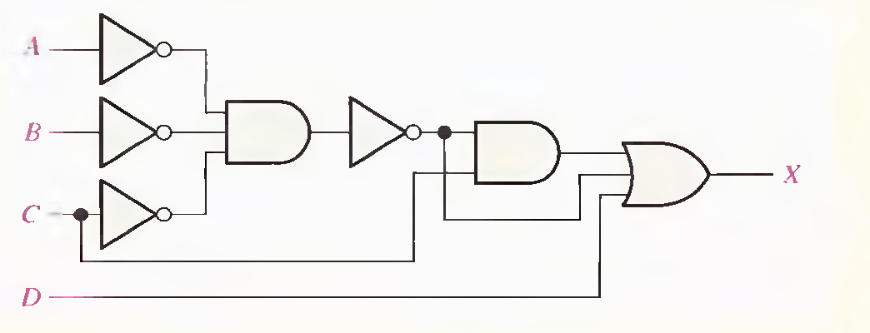
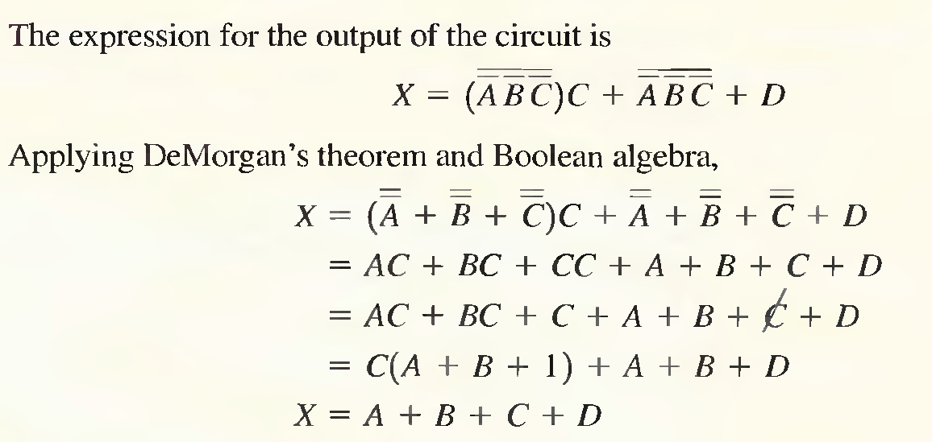
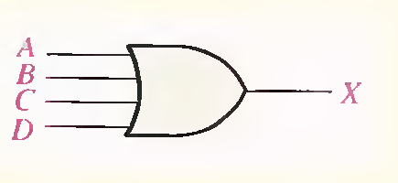
Example

Slide 14
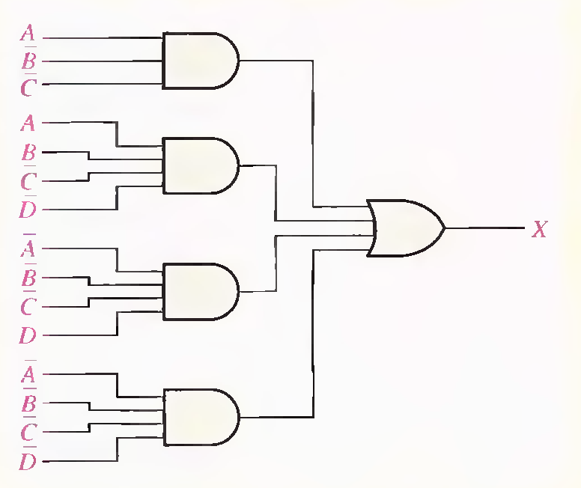
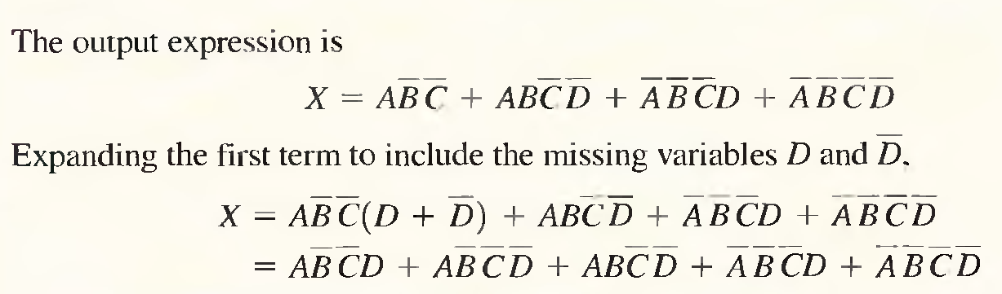
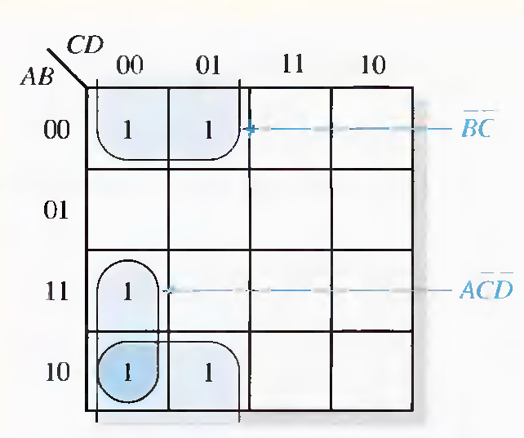
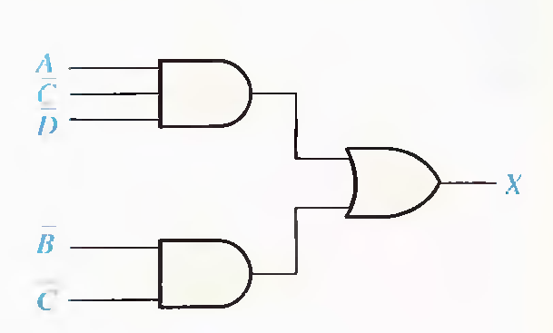
Example

Slide 15
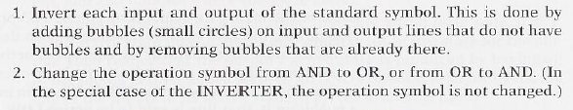
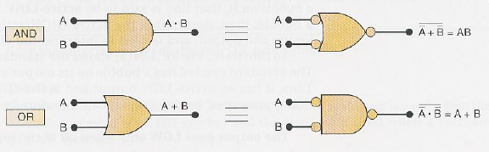
Alternate Logic gate Representations
The alternate symbol for each gate is obtained from the standard symbol by doing the following :

Slide 16
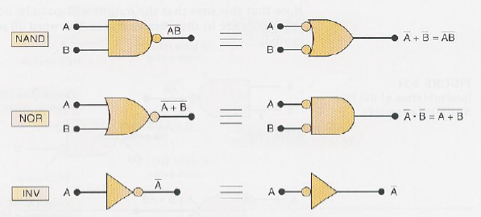

Slide 17
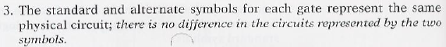
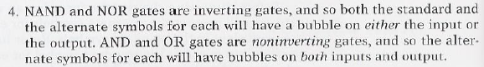
Several point should be stressed regarding the logic symbol equivalences:
Active Logic Levels: There are two active logic levels
Active High : When an input or output line on a logic circuit symbol has
no bubble on it ,that line is said to be active High.
Active Low: When an input or output line does have a bubble on it ,that line is said to be active Low.

Slide 18
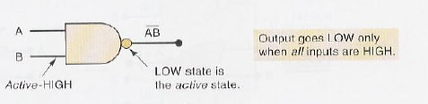
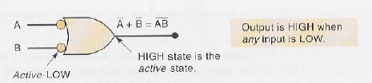
Logic Symbol Interpretation
Word all used because of the AND symbol
Word any used because of the OR symbol
We can see that the two interpretations of the NAND symbols
in figure are different ways of saying the same thing.

Slide 19
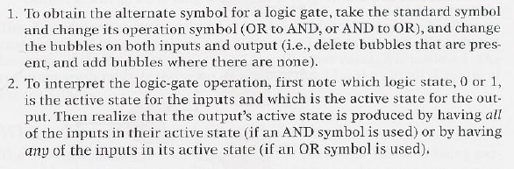
Summary

Slide 20
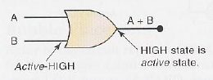
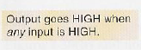
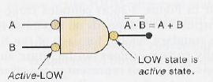
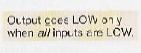
Example

Slide 21
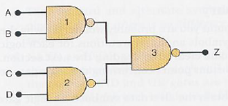
Which Gate Representation to use
Proper use of alternate gate symbol in the circuit diagram can make the circuit operation much clearer.
The circuit diagram uses the standard symbol for each of the NAND gates. While this diagram is logically correct, it does not facilitate an understanding of how the circuit functions.

Slide 22
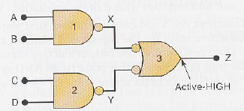
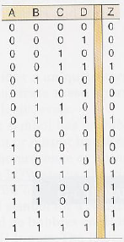
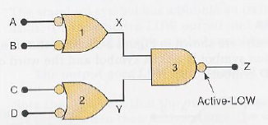
However , these circuits can be analyzed more easily to determine the circuit operation. For all circuits resultant Truth Table is same.
Figure-b
Figure-c

Slide 23
The representation of the figure is obtained from original circuit diagram by replacing NAND gate 3 with its alternate symbol.
Output Z will go active high of X or Y is low.
X will go low only if A=B= 1 and Y will go low only if C=D= 1.
Putting this all together , we can describe the circuit operation as follows:
Output Z will go HIGH whenever either A=B=1 or C=D = 1
Figure - a

Slide 24
The representation of this figure is obtained from original circuit diagram by replacing NAND gate 1 and 2 with its alternate symbol.
Output Z will go active Low only when X = Y =1.
X will go High only if A or B is low and Y will go High only if C or D is low
Putting this all together , we can describe the circuit operation as follows:
Output Z will go LOW only when A or B is Low and C or D is Low.
Figure – c

Slide 25
Which Circuit Diagram Should be Used
The answer to this question depends on the particular function being performed by the circuit output.
If the circuit is being used to cause some action (e.g , turn on an LED or activate another logic circuit) when output Z goes to the 1 state , then we say that Z is to be active –HIGH , and the circuit diagram of figure –b should be used.
On the other hand, if the circuit is being used to cause some when output Z goes to the 0 state , then we say that Z is to be active –LOW , and the circuit diagram of figure – c should be used.

Slide 26
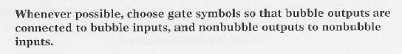
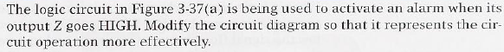
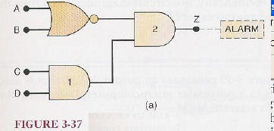
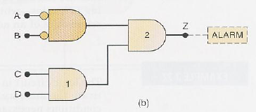
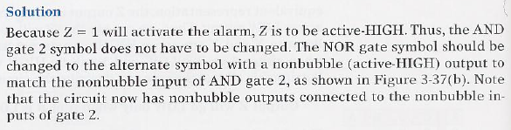
Bubble Placement
Example:

Slide 27
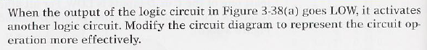
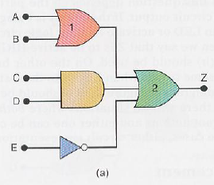
Example:

Slide 28
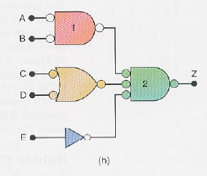
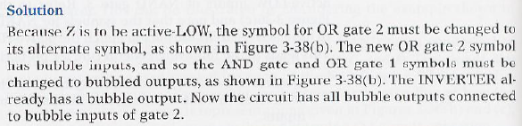
Example:

Slide 29



Analyzing Circuits
When a logic circuit schematic is drawn using the rules we followed in these examples, it is much easier for an engineer or technician (or student ) to follow the signal flow through the circuit and to determine the input condition that are needed to activate the output.
Example:

Slide 30


Slide 31

Example:

Slide 32


Slide 33
Complete Design Procedure
Any logic problem can be solved using the following step by step procedure.
Interpret the problem and set up truth tables to describe its operation.
Write the AND(product) term for each case where the output is 1.
Write the SOP expression for the output.
Simplify the output expression if possible.
Implement the circuit for the final, simplified expression.

Slide 34






Example

Slide 35



Example

Slide 36








Slide 37

Example

Slide 38




Slide 39






Slide 40





